Slide 1
Video Game Narrative
Artistry and Industry

Slide 2
If you could make any game, what would it be?

Slide 3
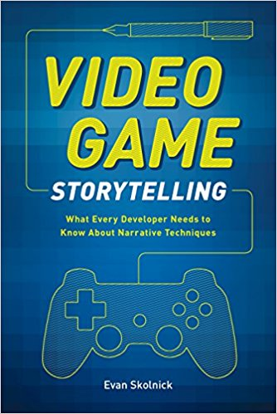

Slide 4
Expectations vs. Reality

Slide 5
“Just so we’re clear, right up front? The chances of you getting any job in the gaming industry are not good.”
“Do you want to write video games?” by David Gaider

Slide 6
What does narrative design/implementation actually look like (on average)?
Director/producer/whoever else starts with an idea
This is usually a main gameplay mechanic (like a shooter or a platformer) with a loose narrative framework
Main level designs/areas are established and built
These tend to coincide with larger story beats
These also take the longest
Narrative is written to fill in the gaps/connect the pieces
Scenes are rewritten, sometimes many times, as the game levels change and evolve

Slide 7
Narrative Roles in Development
Writer
Not involved in design
Creates a story within the design given to them
Narrative Designer
Shapes the story, writes scenes/dialogue
Narrative Implementer
In charge of making sure the narrative elements fit well into the gameplay elements
Dialogue Writer
Only writes dialogue, often just barks
Narrative Director
Oversees all of these other roles

Slide 8
Narrative Roles in Development
Motion Capture Director
VO Director
Creative Director
In charge of maintaining the game’s look/feel/vision
Quest Designer
Designs self-contained levels/quests
Narrative Animator
Animates cutscenes/dialogue scenes
Cinematic Director
Words with mo-cap director, frames cinematics
And so on...

Slide 9
Historically speaking, why are game stories so bad?
Narrative not prioritized in development
Writers not involved in the entirety of the development process (just at the beginning/end)
Writers are working remotely
Writers don’t have experience writing for games
Writers don’t have writing experience at all

Slide 10
Naughty Dog’s Narrative Design Philosophy

Slide 11
Ken Levine on designing a Bioshock sequel

Slide 12
Jonathan Blow on the expectations of “fun”

Slide 13
Capturing a performance
The Last of Us performance capture
Bioshock Infinite VO and motion capture
Kevin Spacey talks about his first time acting in games
Last of Us 2 real-time facial capture

Slide 14
The Gendered History of Game Storytelling

Slide 15
Games for Impact
That Dragon Cancer
1979 Revolution: Black Friday
Papers Please
Depression Quest
etc.

Slide 16
Do you think of games as an artform? Why or why not?

Slide 17
Does better tech = better storytelling?

Slide 18
What are some of your favorite game stories? Why?

Slide 19
Why do you like/want storytelling in games?

Slide 20
How can games be used to discuss important political/social issues?

Slide 21
Why is representation important?

